Slide 1

How to Become a Winner

Slide 2

What is Survivor?
Outwit, Outplay, Outlast to become Sole Survivor
Outwit, Outplay, Outlast to become Sole Survivor
In a complex social game, 18 players compete on a remote island in Fuji in physically and mentally challenging games as they vote people off the island one by one for the chance to win $1 million dollars and the title of Sole Survivor

Slide 3
The Variables
There has been much speculation on what makes a contestant a threat to win the game. Our group has chosen to look at four different variables that are the most commonly talked about.
Rate of success in challenges
If you are a returning player
Age
Personality type

Slide 4
Rate of Success
In Challenges

Slide 5

Hypothesis
Does the rate of change affect your chances of winning?
Null Hypothesis: the rate of challenge wins has no effect on your chances of winning
Alternative Hypothesis: the rate of challenge wins has an effect on your chances of winning

Slide 6
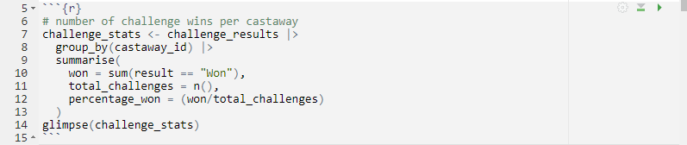
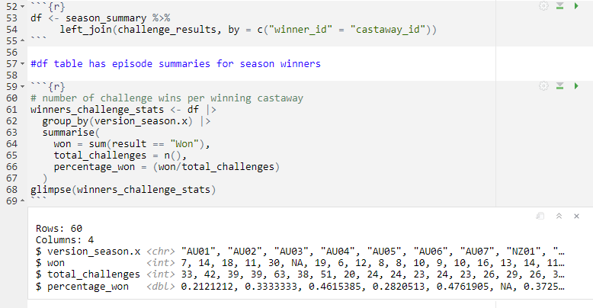
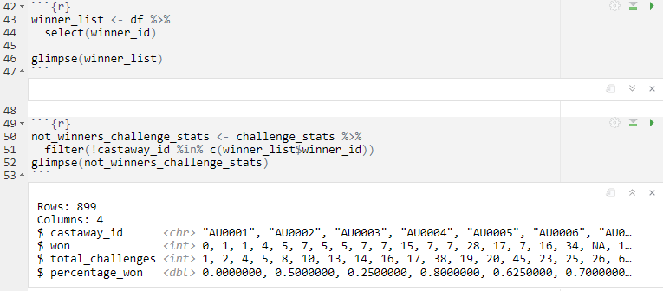
Creating the Data Frame
We first created a table that had number of challenge wins, number of challenges competed in, and the percentage of challenges won:
Next, we created a table to of the data of the contestants who did win their season:
We then filtered this table to isolate contestants who did not win their season:

Slide 7
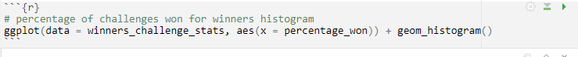
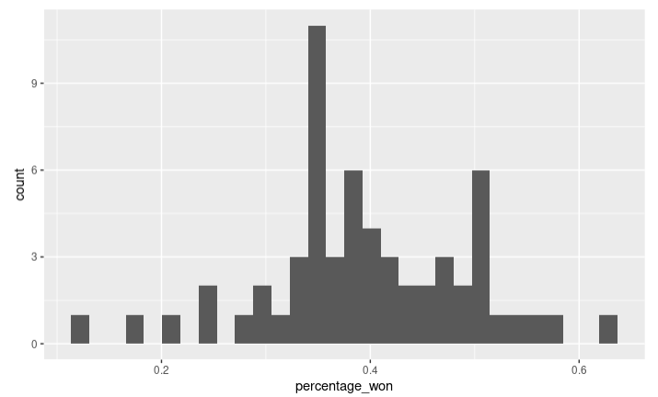
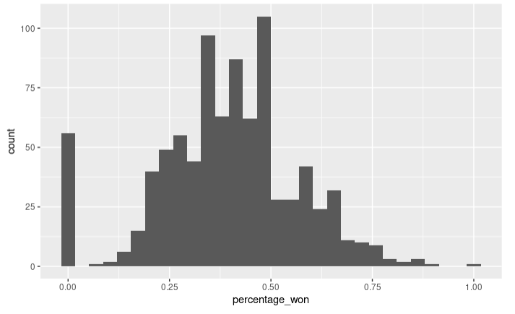
Histograms
Winners
Non Winners
Mean rate of success: 39.5174%
Mean rate of success: 39.4871%

Slide 8
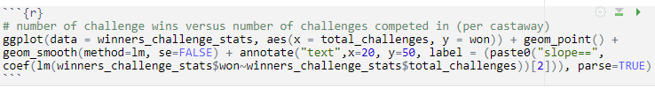
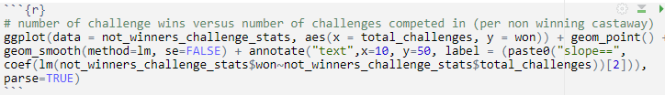
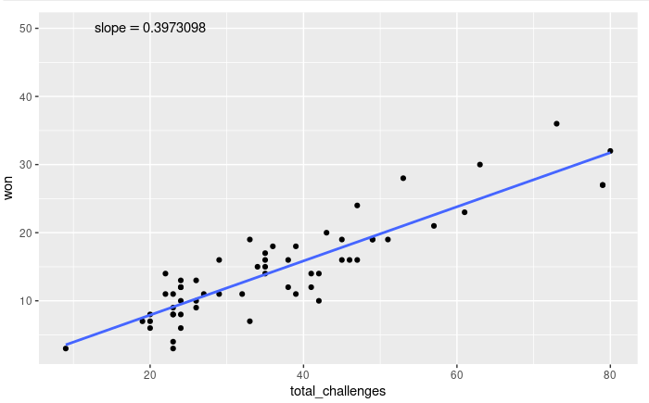
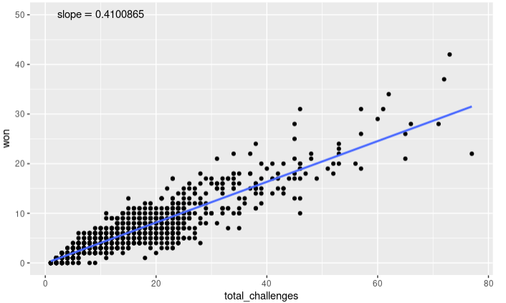
Scatterplots
Winners
Non Winners

Slide 9
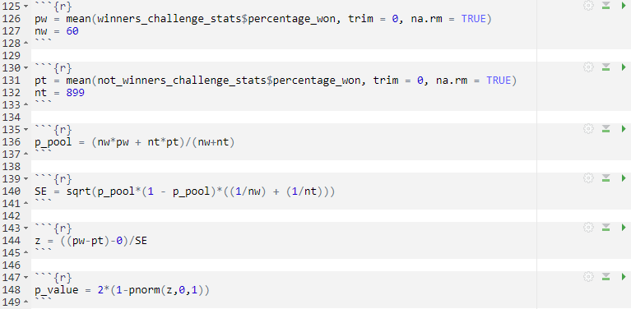
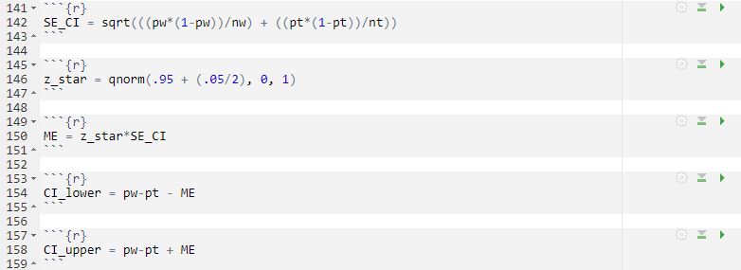
Hypothesis Testing
Does the rate of change of challenge wins affect your chances of winning?
I used an inference for two proportions test and created a confidence interval to check for error

Slide 10
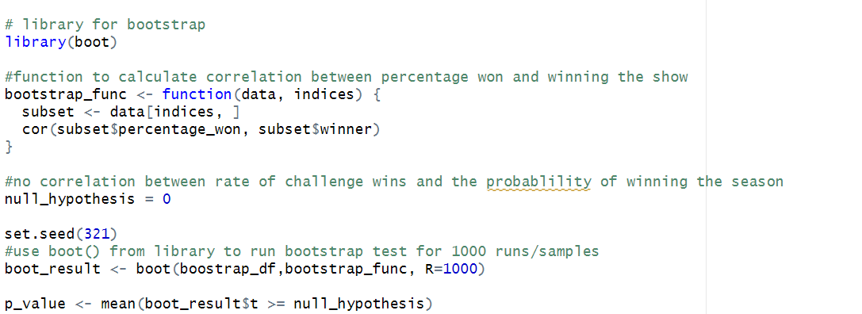
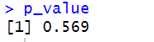
Validation (Bootstrapping)
With an alpha of 0.05 used, the p_value found is greater than the alpha (0.569 > 0.05). Thus, we do not have sufficient evidence to reject the null hypothesis which states there is no correlation between number of challenges won and the probability of winning the season.

Slide 11
Conclusion
I found a p-value of .996 which meant there was not enough evidence to reject the null hypothesis.
My Confidence interval also supported this.
Therefore, the rate of challenge wins does not impact your chances of winning the season.

Slide 12
Returning Players

Slide 13

Hypothesis
If you are a returning player are you more likely to win?
Null Hypothesis: being a returning player has no effect on your chances of winning
Alternative Hypothesis: being a returning player has an effect on your chances of winning

Slide 14
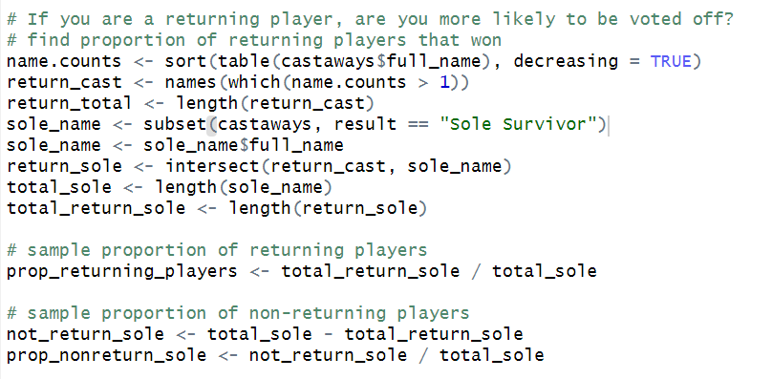
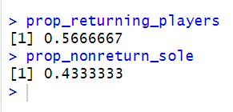
Hypothesis Testing
Results:
Returning: 56.66%
Non Returning: 43.33%
After determining the proportions we can generate the z-score and find the p-value to see if we accept or reject our null hypothesis.

Slide 15
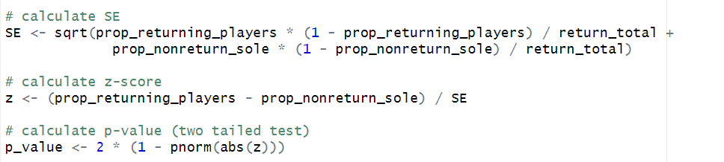
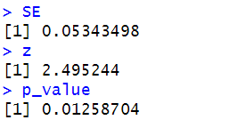
z-Score = 2.49, p-value = .012, which is less than the alpha .005
Based on our findings we reject our null hypothesis because there is enough evidence to show that if someone is a returning player that their chances of winning Sole Survivor goes up by 13.33%

Slide 16
Age

Slide 17

Hypothesis
Does your age affect your chances of winning?
Null Hypothesis: age has no effect on your chances of winning
Alternative Hypothesis: age has an effect on your chances of winning

Slide 18
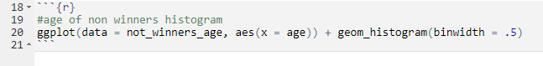
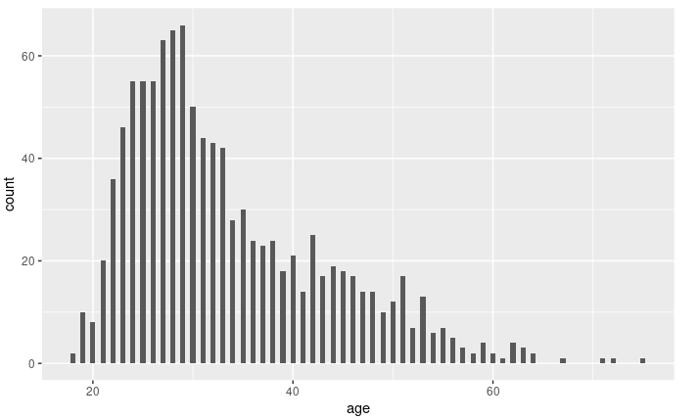
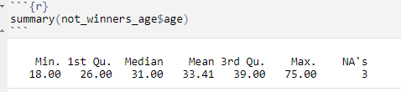
Histogram and Summary Table: Non winners

Slide 19
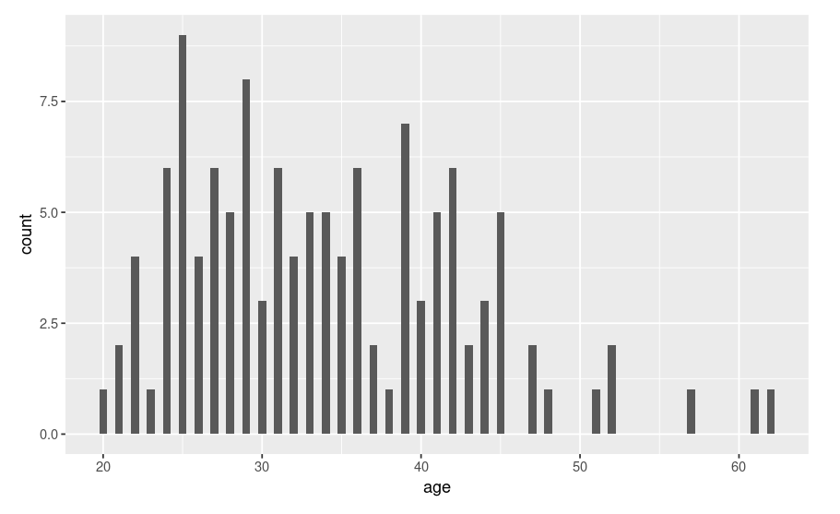
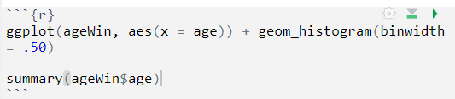
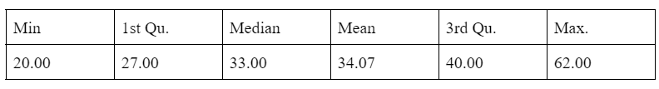
Histogram and Summary Table: Winners

Slide 20
Test the hypothesis:
To test the hypothesis (Does the rate of challenge wins affect your chances of winning?) The following is how the null and alternative hypothesis was formatted:
Null_Hypothesis: Age does not have an impact on chances of winning.
Alternative_Hypothesis: Age does have an impact on chances of winning.
To test this hypothesis, an inference for the difference of
2 means test was used

Slide 21
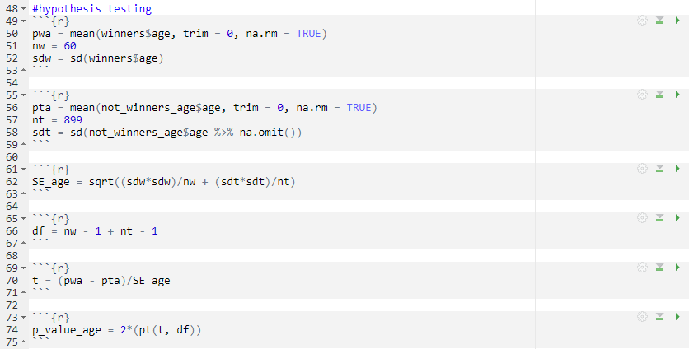
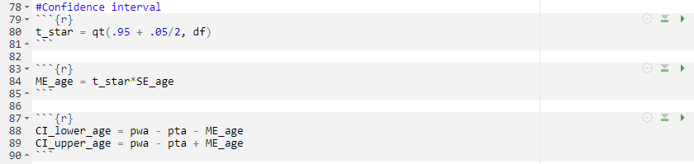
P-value = .4101. A confidence level of 95% was chosen, which means alpha is .05. Because the p-value is higher than alpha, we fail to reject the null hypothesis.
Check for error:
(-3.1881, 1.2998). This means that there is a 95% chance that the difference between the two means is between -3.1881 and 1.2998. This confirms our acceptance of the null hypothesis.

Slide 22
Conclusions
Based on our findings our confidence interval is (-3.1881, 1.2998). This means that there is a 95% chance that the difference between the two means is between -3.1881 and 1.2998. This confirms our acceptance of the null hypothesis that age does not have an impact on winning.

Slide 23
Personality Type

Slide 24
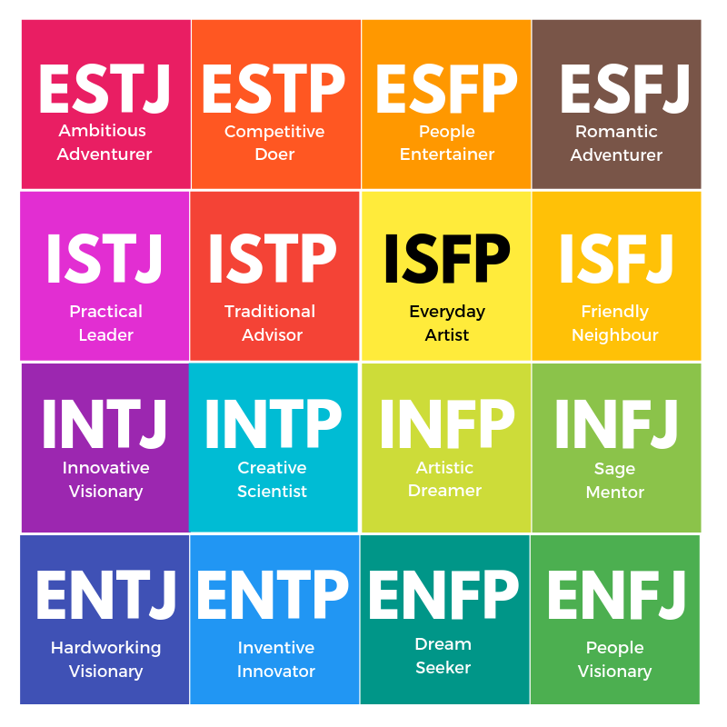
Hypothesis
Does your personality type affect your chances of winning?
Null Hypothesis: personality type has no effect on your chances of winning
Alternative Hypothesis: personality type has an effect on your chances of winning

Slide 25
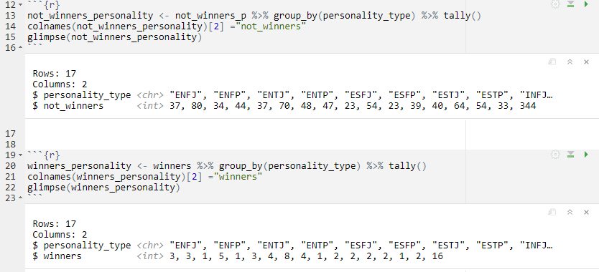
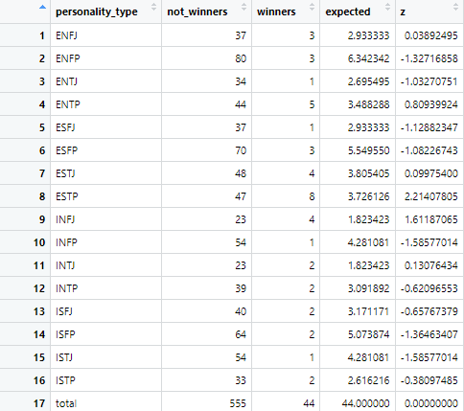
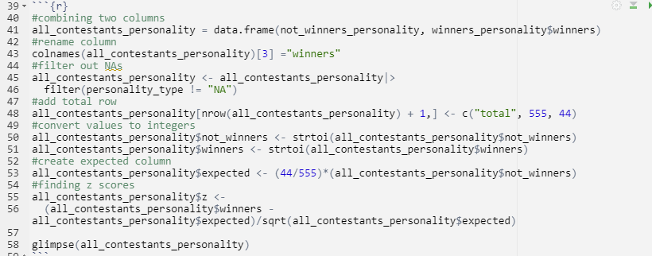
Creating the Data Frame
We first found the number of each personality type in both winners and non winners:
Next, we combined these two tables to create a comparison table. We also added a column to compute the expected number of winners, and a z score to compare the expected and the result:

Slide 26
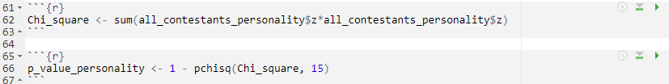
Hypothesis Testing
Does your personality type affect your chances of winning?
I computed a p-value using my z values and a Chi-Square test

Slide 27
Conclusion
We found a p-value of .1271 which meant there was not enough evidence to reject the null hypothesis.
Therefore, the rate of challenge wins does not impact your chances of winning the season.
However, there was one personality type with a high core meaning these people won more than expected.

Slide 28
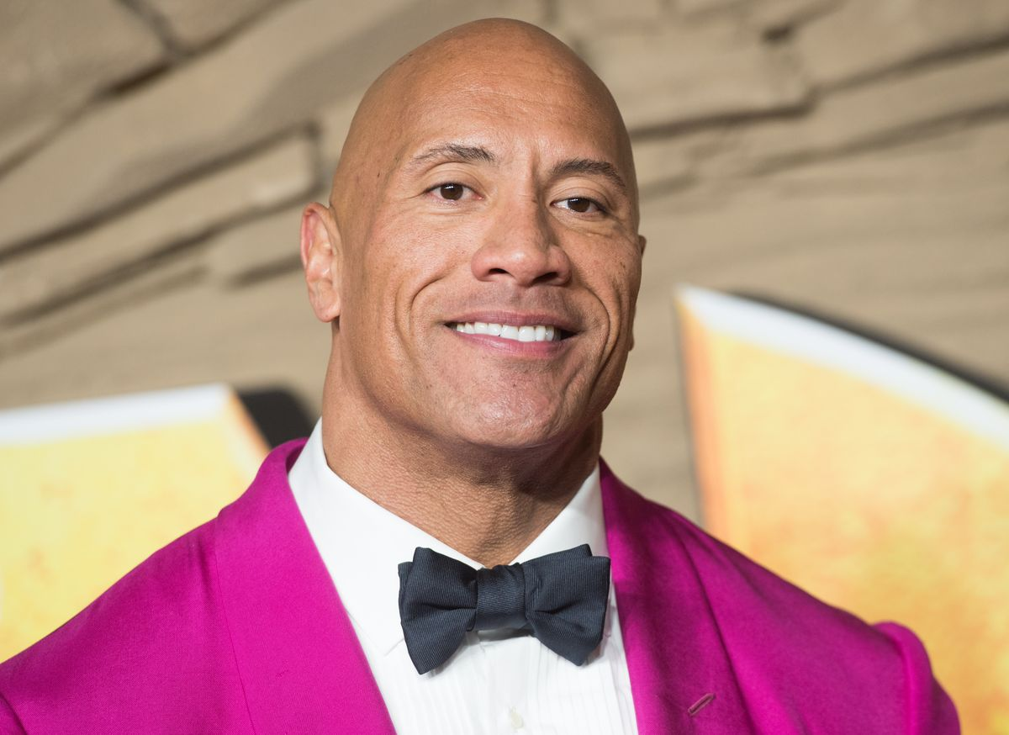

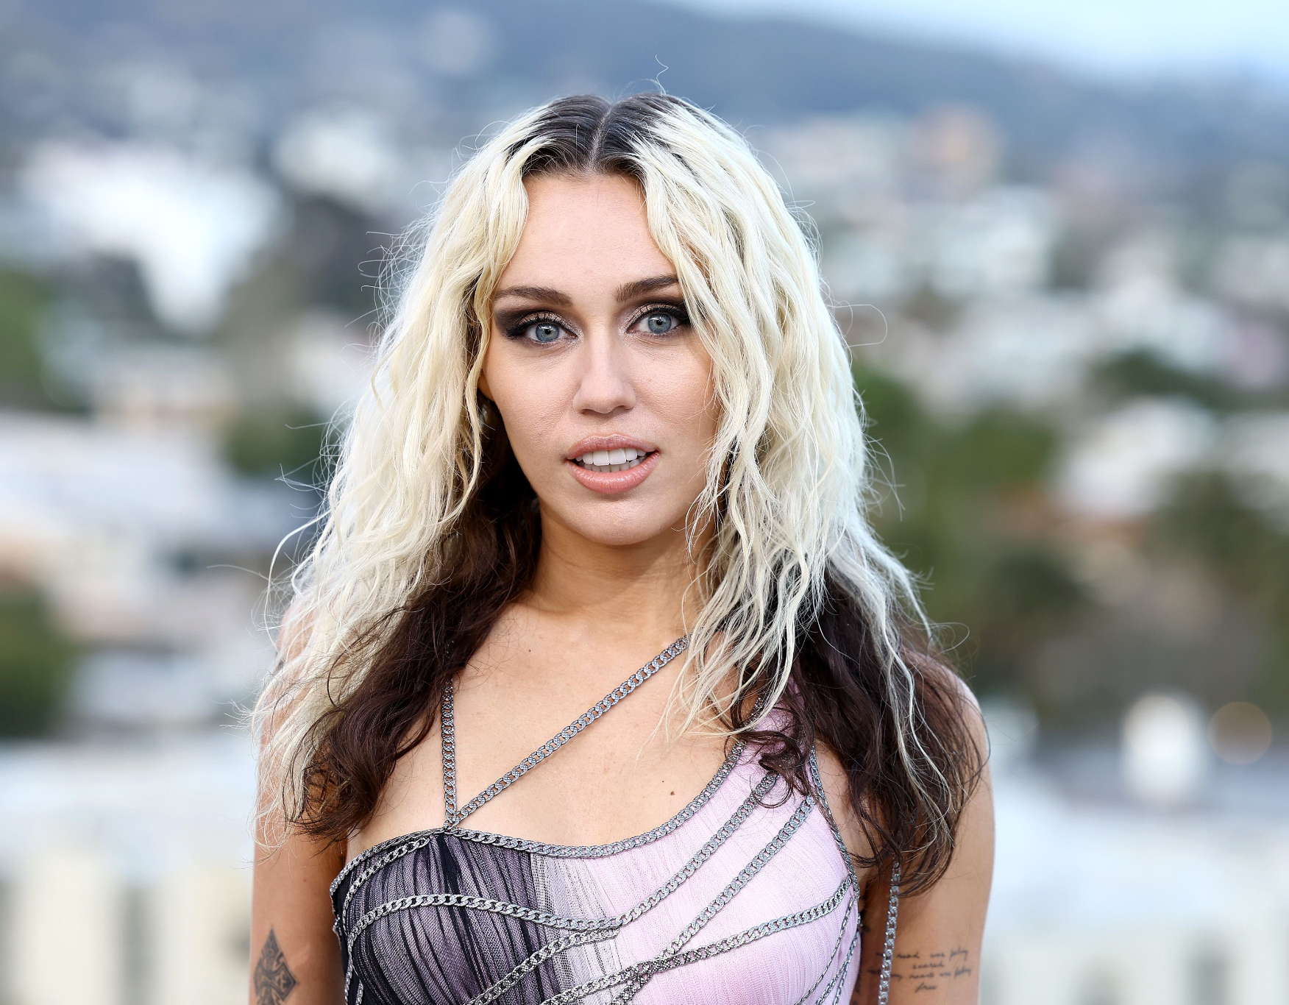
Best Personality Type
The personality type with the highest z score of 2.214 is the ESTP or entrepreneur personality type.
This personality is characterized as
Energetic
Observant
Impulsive
Competitive

Slide 29
Conclusion

Slide 30

Conclusion
Based on our findings we discovered that while having more challenge wins gave these Survivors a leg up, challenge wins, age, and personality types doesn’t have a substantial impact on winning Survivor. However, being a retuner player does. We conclude that in the end one’s social game has the most impact on being the winner.
Challenge Wins
X
Returning Player
X
X
Age
Personality Type

